Slide 1
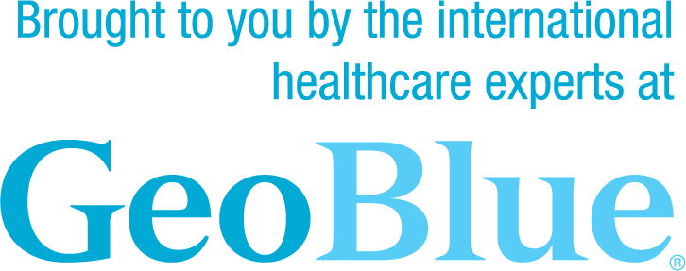
Worldwide Coverage from the Carrier You Know and Trust
SOLELY DEDICATED TO SERVING THE GLOBALLY MOBILE FOR OVER 25 YEARS
Specialized Benefits and Capabilities for Expatriates and International Travelers
Strength and breadth of BCBS network (inside U.S.) and Bupa Global (outside of U.S.)
Industry-leading digital tools
24/7/365 high-touch
multi-lingual service
Centralized in-house service, claims and medical assistance
Access to global telemedicine and wellness resources
Flexible, comprehensive benefit options
Blue Cross Blue Shield Global is a Brand owned by Blue Cross Blue Shield Association. Bupa Global is a trade name of Bupa, an independent licensee of Blue Cross Blue Shield Association, an association of independent Blue Cross and Blue Shield companies. GeoBlue is the trade name of Worldwide Insurance Services, LLC (Worldwide Services Insurance Agency, LLC in California and New York), an independent licensee of the Blue Cross and Blue Shield Association and is made available in cooperation with Blue Cross and Blue Shield companies in select service areas. Coverage is provided under insurance policies underwritten by 4 Ever Life Insurance Company, Oakbrook Terrace, IL, NAIC #80985. 4 Ever Life Insurance Company is an independent licensee of the Blue Cross and Blue Shield Association.

